Slide 1
Strategic Plan Part 2
By: Danielle Opbroek

Slide 2
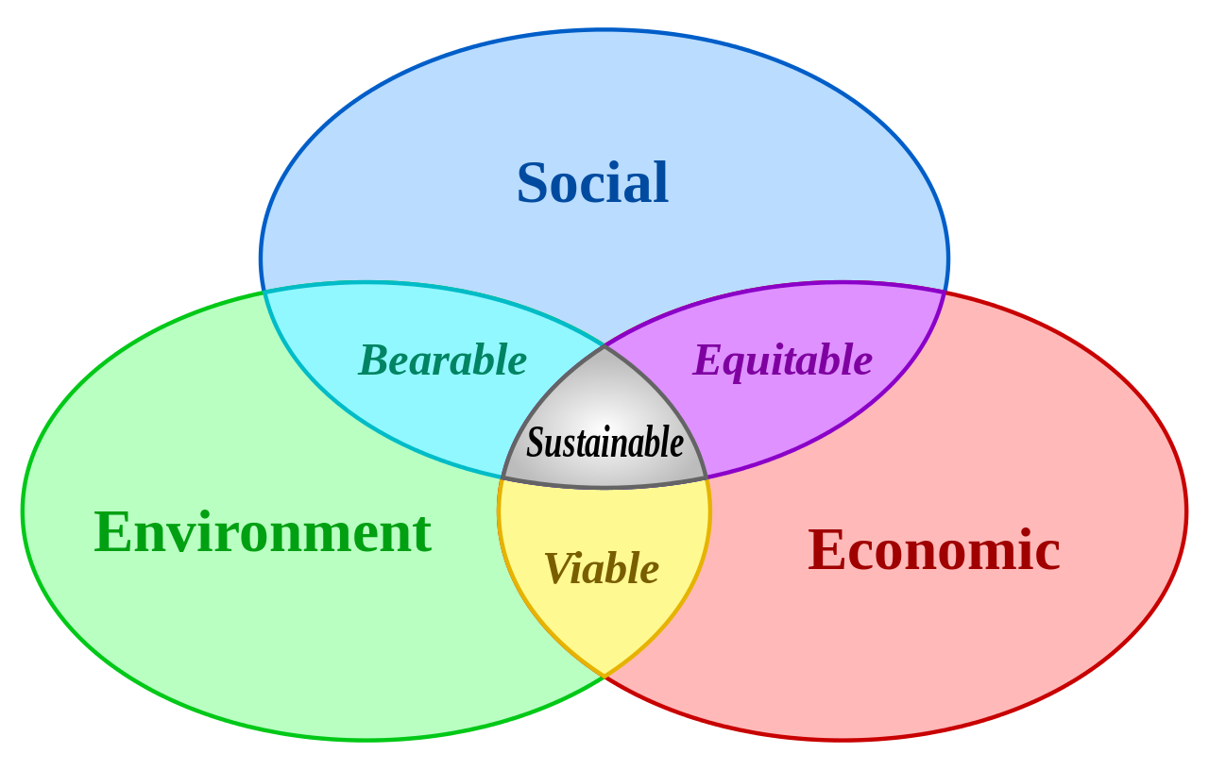
Environmental Scan: Environmental scanning is defined as the study and interpretation of the political, economic, social and technological events and trends which influence a business, an industry or even a total market. (MSG, 2016)

Slide 3
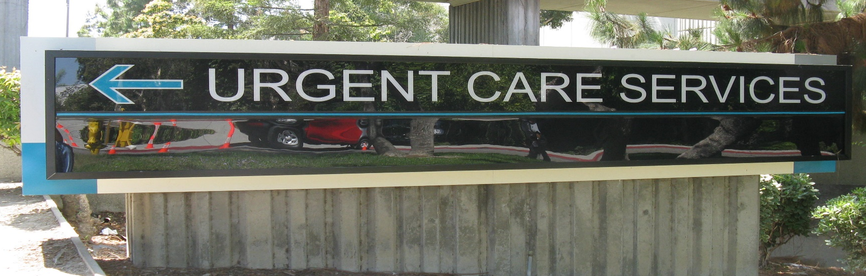
Overview of the Plan: The market expansion of urgent care and the outsourcing to medical health care groups.

Slide 4
What the Industry is doing
Urgent care began, as far as anyone can tell, in the late 1970s and was created to meet a need in a community.
Recent industry growth (last 5 years) seems to be fueled by a confluence of events and awareness - primary care being somewhat hard to come by, emergency room wait times and overcrowding spreading, physicians seeing and acting on these needs in their communities, and patients driving their popularity. Most recently, the private equity community has noticed urgent care as a viable business model and their investments have also fueled growth from within the industry itself.
Healthcare groups are trying to see their patients but unable to meet the need of seeing the urgent patients. The urgent cares are being operated by either healthcare groups that are not equipped or the private sector who is making profit off seeing medical group patients.
Notes:
The ability to have local urgent cares has proven to help the community in providing nonemergent care at affordable cost. This allows the members of the community the ability to seek the care that they need from sore throat and stitches to broken bones and chest pain(Urgent Care Association of America, 2016).
The recent growth in urgent cares are continuing to grow and there are several that operate that are privately owned and have no affiliation with medical groups. There are some that the medical groups themselves are trying to run. What my company will do is contract with the medical groups so that their patients will be able to be seen and cared for with top quality care. This allows for the medical groups to focus on the primary medicine that they were designed for.

Slide 5
Our Organization
Is able to provide quality care and a caring environment to the patients of the medical group that are contracted with us.
Saving the medical groups that contract with us money on staffing, space, and equipment. We take and care for your patients and are able to work with the medical groups by incorporating the patients visit with the patients primary care team.
By charging a small percentage of what an average visit cost we are able to provide this service to the medical groups.
(Emergency Rooms vs. Urgent Care Centers: Differences in Services & Costs, 2016)
Condition | Urgent Care Cost
Allergies | $97
Acute Bronchitis | $127
Earache | $110
Sore Throat | $94
Pink Eye | $102
Sinusitis | $112
Strep Throat | $111
Upper Respiratory Infection | $111
Urinary Tract Infection | $112
Notes:
The average cost for starting an urgent care from scratch is $800,000(Urgent Care Association of America, 2016). With contracting with one of our urgent cares we will honor the patients copay that the affiliate medical group charges and then with our cobilling with your medical group be able to provide care to your patients.

Slide 6
External and Internal Assessment Tools
There are several key sources that can be used to retrieve external and internal assessments. External forces can be divided into five basic categories. The first being economic forces, the second political, government and legal forces, the third social, cultural, demographic and natural forces. The fourth is technological forces and the fifth is competitive forces (David, 2016).
The use of internal audit identifies the company's strength and weaknesses. In my company I will be looking at the following areas and how using strategic imitative and internal assessment tools to evaluate the strengths and weaknesses of the company(David, 2016).
Management – Using a strategic checklist to determine where the strength and weaknesses are.
Marketing – Using customer analysis and trending with volume of customers visiting versus the competitor’s volume.
Finance/ Accounting – using financial ratios and Breakeven analysis
Productions/operations – using quality and inventory control as well as using the production and operations audit checklist
R&D – by pulling daily stats and comparing to the outside data that we will get from the external audit.
MIS – Using the audit checklist to make sure that all data is being used and understood.

Slide 7
How the internal and external influenced the decision making process
Internal
External
Management
Marketing
Finance/Accounting
Productions/operations
Research/Development
Management information systems
Economic
Political
Social
Technological
Competitive Forces
Notes:
Internal – management looking at the SWOTT report it tells us that our management team is strong and is able to handle many situations and has a high ASQ score.
Marketing – according to the SWOTT report this is an area that will need some more work as we need to improve on getting our name out there and make more contracts with other medical groups.
Finance/Accounting this are has been doing well as it works in collaboration with the billing and accounts payable of the contracted medical groups as well as the private pay patients that are coming in. The company is seeing a small profit and we continue to grow.
Productions/operation – According to the SWOTT this is doing well as number of medical groups are contracting with us and our ASQ scores indicate.
External –
Economic – With a start up of the average urgent care costing 800,00 the ability to work with the medical groups in acquiring key equipment for diagnosing allowed for monies to be directed to areas like marketing and better patient areas.
Political – this proved to very important as many legal guidelines by county and state had to be followed. In order to purchase land the local government was involved to get the proper permits.
Social – knowing what the needs of the community are and apply those to taking care of patients
Technological – Being able to have latest equipment and computer charting for the business that means having charting systems that each medical group can access.
Competitive forces - Having 2 other urgent cares that are currently operating in the area. By having the contract with medical group guaranties patients and the bill to be paid this is our competitive edge.

Slide 8
Key Issues
Having the software that is able to communicate with different types of charting for each medical group.
Recommendation: Have several designated computers that have the health care program for that medical group so that those patients being seen can be charted on.
2. It may take up to 3 years to break even according to the break even history of other urgent cares(The Daily Briefing, 2013).
Recommendation: By having the contracts and using donated large equipment the cost of start up is then reduced and therefore making the breakeven less than 3 years.

Slide 9
Outline of the Strategic Plan: 1. Network and gain medical group contracts. 2. Acquire software in order to chart on the different medical documents. 3. Continue to grow based on profit and open another urgent care within 3 years. 4. Continuing with the culture of caring that is outlined in the mission and vision statement. 5. Continue to stay in regulations for city, county, state and federal and laws to maintain the highest quality of patient care.

Slide 10
References
David, F. (2016). Strategic Management: A competitive Advantage Approach Concepts and Cases 16th ed. Upper Saddle River, NJ: Pearson.
Emergency Rooms vs. Urgent Care Centers: Differences in Services & Costs. (2016, June). Retrieved from https://www.debt.org/medical/emergency-room-urgent-care-costs/: https://www.debt.org/medical/emergency-room-urgent-care-costs/
MSG. (2016, June). Retrieved from MSG Environmental Scanning - Internal & External Analysis of Environment: http://www.managementstudyguide.com/environmental-scanning.htm The Daily Briefing. (2013, January). Retrieved from Advisory.com: https://www.advisory.com/daily-briefing/2013
Urgent Care Association of America. (2016, June). Retrieved from http://www.ucaoa.org/general/custom.asp?page=IndustryFAQs#Healthcare Reform: http://www.ucaoa.org/general/custom.asp?page=IndustryFAQs#Healthcare Reform

